Slide 1
Regression Analysis
Analysis of Variance
Nicoleta Serban, Ph.D.
Professor
School of Industrial and Systems Engineering
Parameter Estimation

Slide 2

About This Lesson

Slide 3
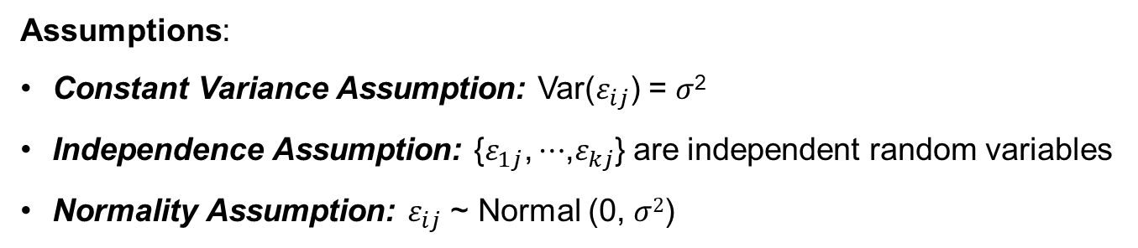
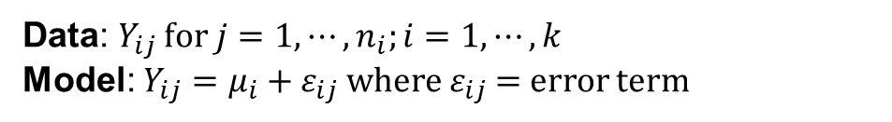
ANOVA: Model & Assumptions
Data: $Y_{ij}$ for $j=1,⋯,n_{i};i=1,⋯,k$
Model: $Y_{ij}=μ_{i}+ε_{ij}$ where $ε_{ij}$ = error term
Assumptions:
Constant Variance Assumption: Var($ε_{ij}$) = $σ$²
Independence Assumption: {$ε_{1j}\text{,}⋯$,$ε_{kj}$} are independent random variables
Normality Assumption: $ε_{ij}$ ~ Normal (0, $σ$²)

Slide 4
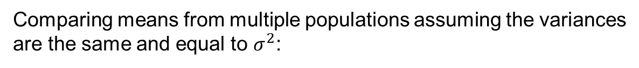
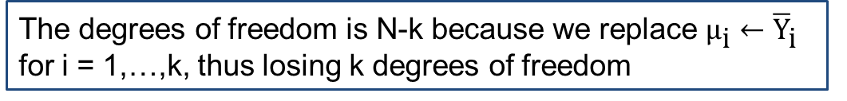
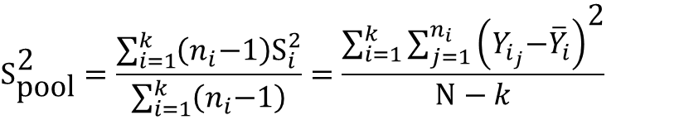
ANOVA: Variance Estimation
Comparing means from multiple populations assuming the variances are the same and equal to $σ^{2}$:
Pooled Variance Estimator:
$${\text{S}}_{\text{pool}}^{\text{2}}=\frac{\sum_{i=1}^{k}{\left(n_{i}\text{−1}\right){\text{S}}_{i}^{2}}}{\sum_{i=1}^{k}{\left(n_{i}\text{−1}\right)}}=\frac{\sum_{i=1}^{k}{\sum_{j=1}^{n_{i}}{{\left(Y_{i_{j}}\text{−}{\overline{Y}}_{i}\right)}^{\text{2}}}}}{N−k}$$
Where N = total number of samples = (n₁ +…+ n_{k})
The degrees of freedom is N-k because we replace ${\text{μ}}_{\text{i}}←{\overline{\text{Y}}}_{\text{i}}$ for i = 1,…,k, thus losing k degrees of freedom

Slide 5


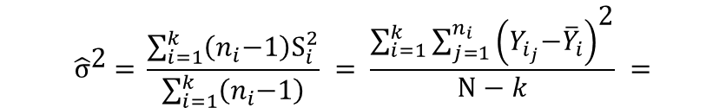
ANOVA: Variance Estimation (cont’d)
$${\hat{\text{σ}}}^{\text{2}} \text{=} \frac{\sum_{i=1}^{k}{\left(n_{i}\text{−1}\right){\text{S}}_{i}^{2}}}{\sum_{i=1}^{k}{\left(n_{i}\text{−1}\right)}} = \frac{\sum_{i=1}^{k}{\sum_{j=1}^{n_{i}}{{\left(Y_{i_{j}}\text{−}{\overline{Y}}_{i}\right)}^{\text{2}}}}}{N−k} =$$
MSE
$$\sum_{i=1}^{k}{\sum_{j=1}^{n_{i}}{{\left(Y_{i_{j}}\text{−}{\overline{Y}}_{i}\right)}^{\text{2}}}}$$
$=$ Sum of Squares of Error $=$ SSE
We will use interchangeably Sum of Squared Errors and Sum of Squared Residuals.

Slide 6
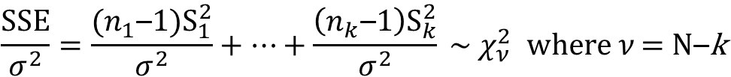

Mean Squared Error (MSE)
$S_{1}^{2}$,…,$S_{k}^{2}$
The sum of independent chi-square random variables is also chi-square
$$\frac{SSE}{σ^{2}}=\frac{(n_{1}\text{–}1)S_{1}^{2}}{σ^{2}}+⋯+\frac{\left(n_{k}\text{–}1\right)S_{k}^{2}}{σ^{2}} \sim χ_{ν}^{2} \text{where} ν\text{ = }\text{N}\text{–}\text{k}$$
The sampling distribution of the pooled variance is a chi-square distribution with N-k degrees of freedom.

Slide 7


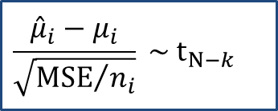
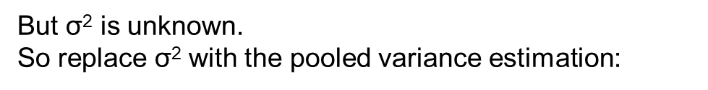

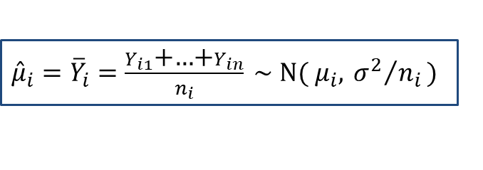
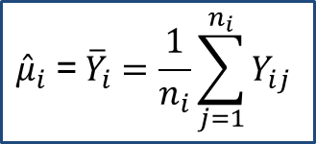
Estimating Parameters in ANOVA
$${\hat{μ}}_{i} \text{=} {\overline{Y}}_{i}=\frac{\text{1}}{n_{i}}\sum_{j=1}^{n_{i}}{Y_{ij}}$$
What is the sampling distribution?
If $Y_{i1}\text{,…,}Y_{in} \text{\sim }\text{N}\text{(}μ_{i}\text{,}{ σ}^{2}\text{)}$
${{\hat{μ}}_{i}=\overline{Y}}_{i}=\frac{Y_{i1}\text{+…+}Y_{in}}{n_{i}} \text{\sim }\text{N}\text{(} μ_{i}\text{,}{ σ^{2}}/{n_{i}}\text{)}$
But $\text{σ}\text{2}$ is unknown.
So replace $\text{σ}\text{2}$ with the pooled variance estimation:
$\text{σ}\text{2}$ MSE
$$\frac{{\hat{μ}}_{i}−μ_{i}}{\sqrt{{MSE}/{n_{i}}}} \sim t_{N−k}$$
Why N – k?
$$MSE={\hat{σ}}^{2}\sim χ_{N−k}^{2}$$

Slide 8
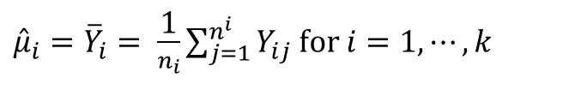
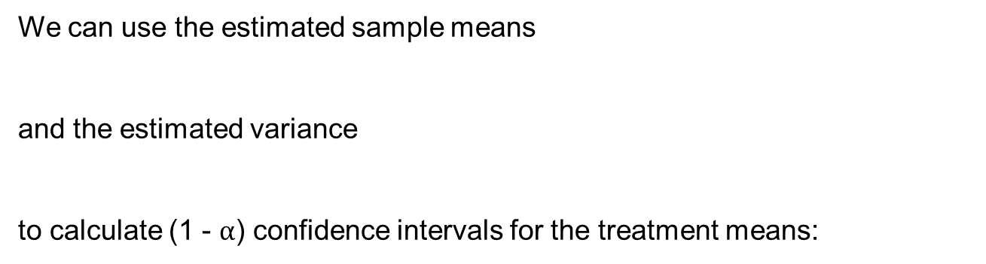
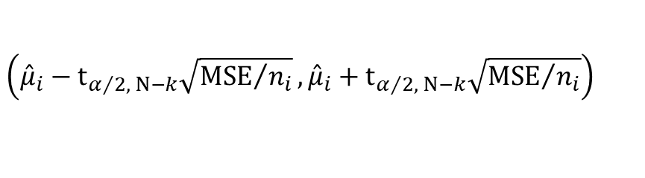

Confidence Intervals for the Means
We can use the estimated sample means
and the estimated variance
to calculate (1 - $α$) confidence intervals for the treatment means:
${\hat{μ}}_{i}={\overline{Y}}_{i}= \frac{\text{1}}{n_{i}}\sum_{j=1}^{n^{i}}{Y_{ij}}$ for $i=1,⋯,k$
$${\hat{σ}}^{2}=MSE$$
$$\left({\hat{μ}}_{i}−t_{α/2, N−k}\sqrt{{MSE}/{n_{i}}}, {\hat{μ}}_{i}+t_{α/2, N−k}\sqrt{{MSE}/{n_{i}}}\right)$$

Slide 9

Summary

